Slide 1
UI Design of Food Ordering Website
Presented By
Saurabh Ganatra
Jay Bhadreshwara
Dev Shah

Slide 2
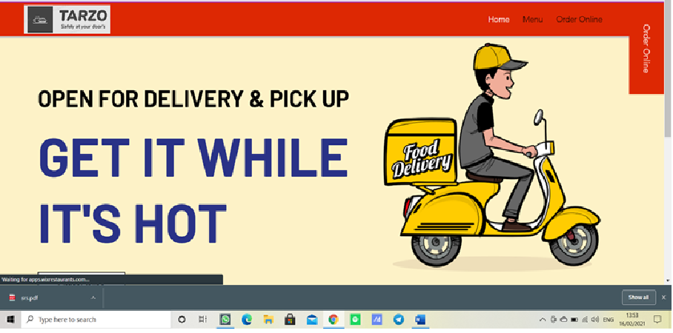

Slide 3
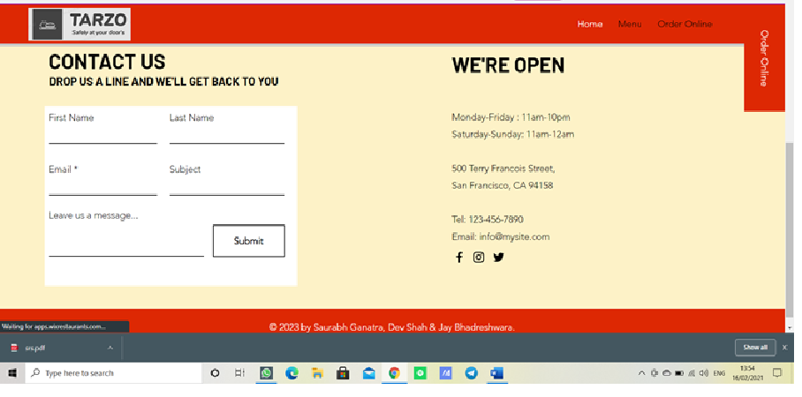

Slide 4
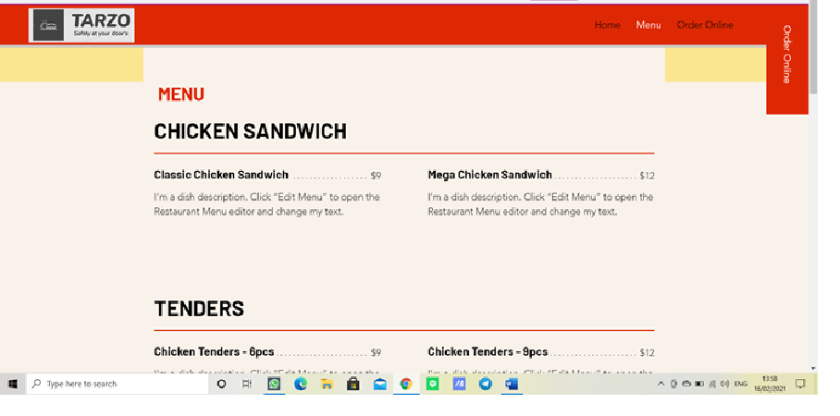

Slide 5
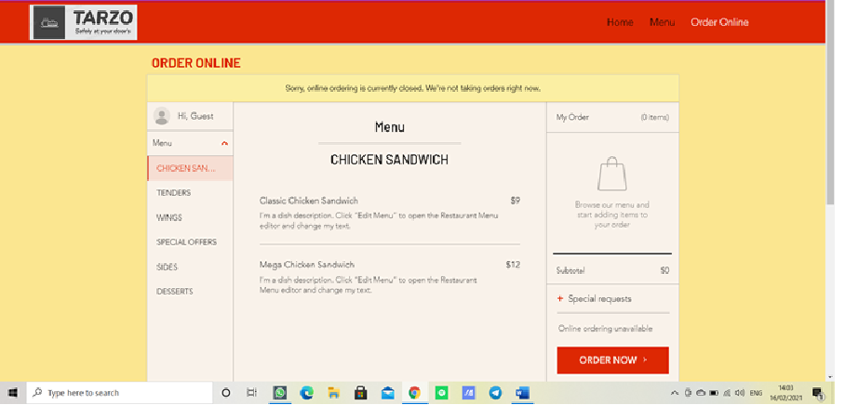

Slide 6
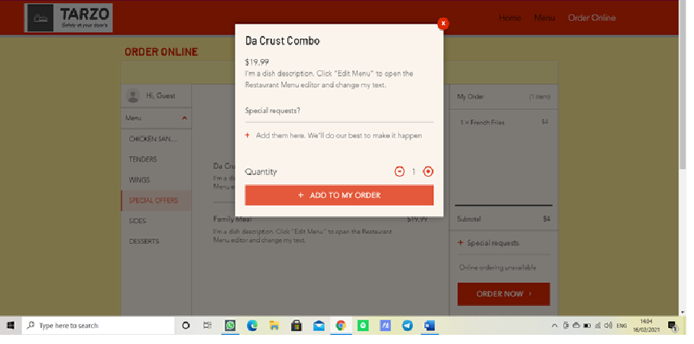

Slide 7
THANK YOU….

